Slide 1

Hardware/Software Codesign Guidelines for System on Chip FPGA-Based Sensorless AC Drive Applications

Slide 2

AC Motors &
Servo Systems
Working Principle
Architectural Segmentation/
Representation/Partitioning
Control Algorithm Requirements
Simulink Simulation
Experimental Topology

Slide 3

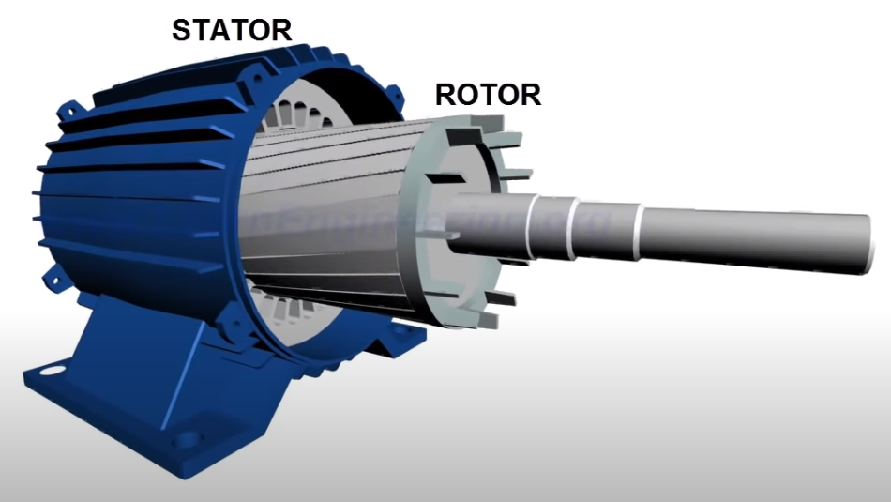
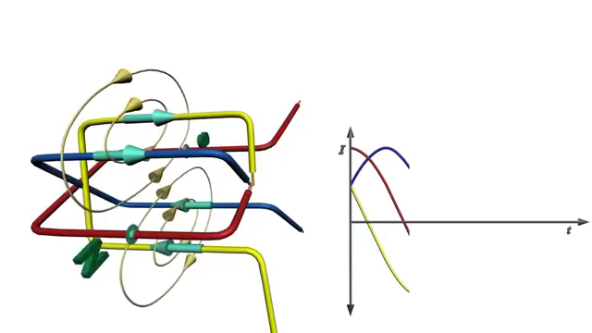
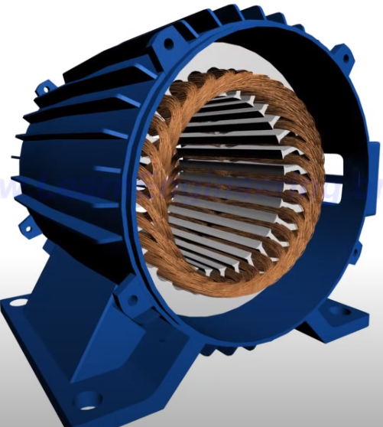


Synchronous Motors
Hardware/Software Codesign Guidelines for System on Chip FPGA-Based Sensorless AC Drive Applications
$τ=k ∗ {B_{s}xB}_{r}$
Electric Motors
$ω_{r}= \frac{2}{P}∗ω_{s}$
DC Motors
AC Motors
Asynchronous
Synchronous
Stator Windings
Rotating Magnetic Field of Stator

Slide 4
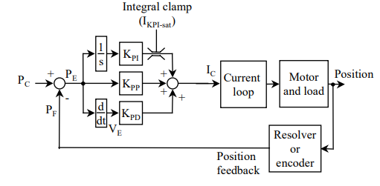
Simple Servo System with Sensor Feedback
Hardware/Software Codesign Guidelines for System on Chip FPGA-Based Sensorless AC Drive Applications
Closed Loop Servo System

Slide 5
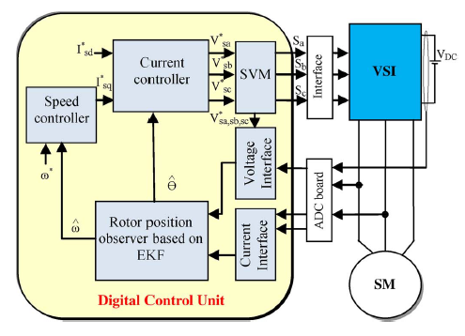
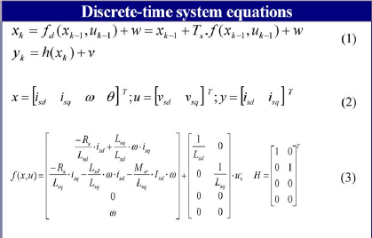
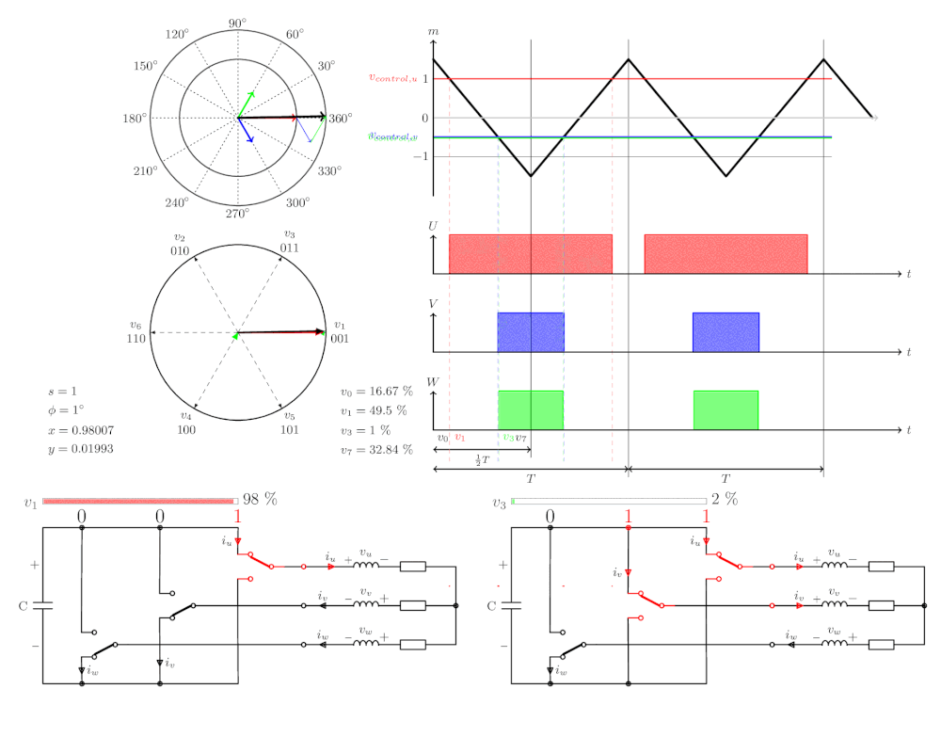
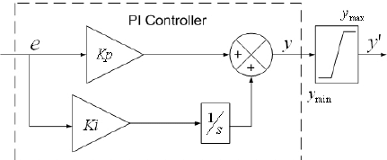
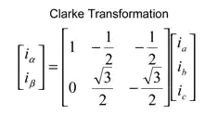
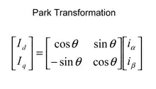
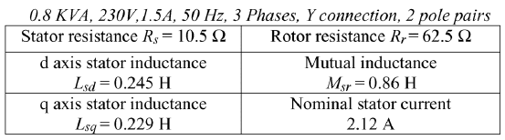
Sensorless Servo System
Hardware/Software Codesign Guidelines for System on Chip FPGA-Based Sensorless AC Drive Applications
Extended Kalman Filter Equations(EKF)
Space Vector Modulation (SVM)
Opens & Closes the Inverter (VSI) switches (IGBT)
Inverse Clarke-Transformation
Speed Controller (PI)
-Input = Desirable Velocity (ω)
-Input = Id (Torque), Iq(Magnetic Flux)
-Output = Current Reference Signal (Isq)
-Output = 3phase Current Signals
Schematic of the Control Application (Speed Controller)
Motor Characteristics

Slide 6
AC Motors &
Servo Systems
Working Principle
Control Algorithm Requirements
Simulink Simulation

Slide 7






Control Algorithm Requirements
Hardware/Software Codesign Guidelines for System on Chip FPGA-Based Sensorless AC Drive Applications
The control Algorithm must achieve:
$$F_{c}≤ \frac{F_{s}}{20}$$
Rule of thumb:
High Bandwidth
Stability (Phase Margin)
Sampling Period:
$$T_{s}=100μs => F_{s}=10kHz$$
Disturbance Rejection
System Bandwidth:
$$F_{c}=500Hz$$
$$T_{d}≤ \frac{\frac{π}{2}−φ_{m}}{2∗π∗F_{c}}$$
Phase Margin:
$$φ_{m}=60°$$
$$T_{alg}≤ T_{d}−\frac{T_{s}}{2}$$
Execution Time:
$$T_{alg}=116.67μs$$

Slide 8
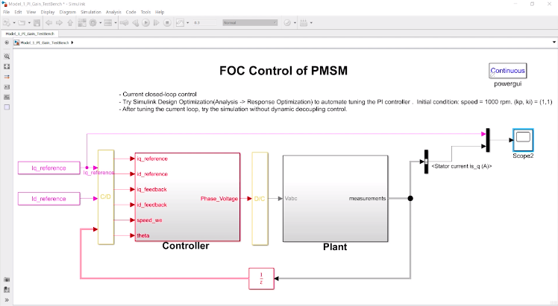
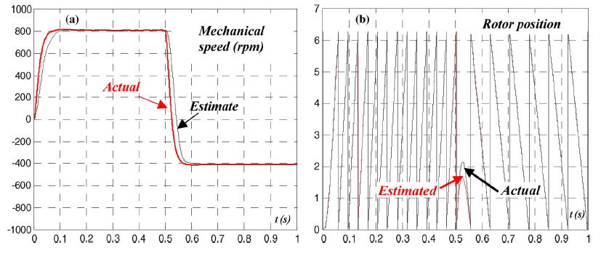
MATLAB/Simulink Simulation
Hardware/Software Codesign Guidelines for System on Chip FPGA-Based Sensorless AC Drive Applications
Simulink Simulation in order to tune the PI and EKF Gains
Simulink Simulation in order to evaluate the functionality of the control algorithm in continuous-time domain
Simulink Servo System Model
Simulink Simulation results
Comparison of Predicted/Actual Speed & Position
Simulink Simulation Results

Slide 9
AC Motors &
Servo Systems
Working Principle
Architectural Segmentation/
Representation/Partitioning
Control Algorithm Requirements
Simulink Simulation

Slide 10
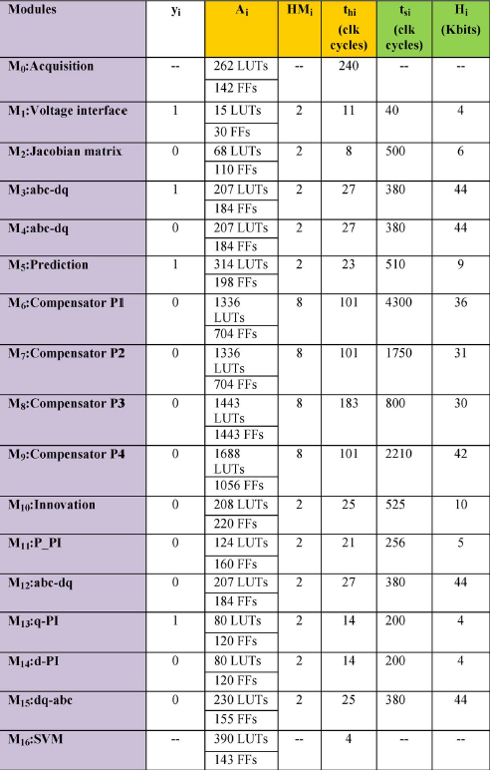
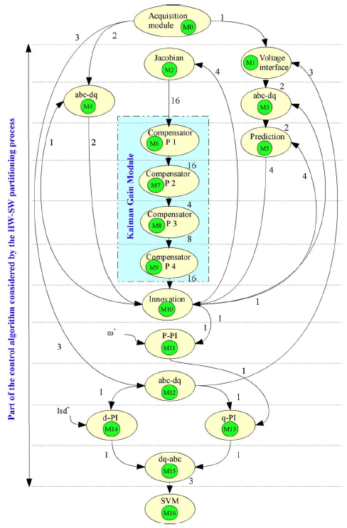
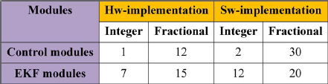
Architectural Segmentation & Representation
Hardware/Software Codesign Guidelines for System on Chip FPGA-Based Sensorless AC Drive Applications
Node = Process
Ai -> LUT & FFs
HMi -> Hardware Multipliers (DSPs)
Edge = Data Dependency
Thi = Hardware Execution Time
Tsi = Software Execution Time
Parallel Processes are on the same height
Hi = Memory Blocks
Edge directions shows the order of the execution
yi = Parallelism Variable
Edge weights show the number of exchanged data between nodes
Bit Number and Fixed Point Formats
Control Modules/Processes
Synchronous Directed & Weighted Data Flow Graph Representation of the Processes

Slide 11
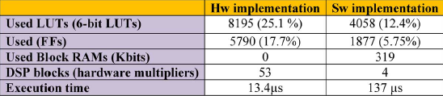
Previous Research of Fully Hardware and Fully Software Implementations
Hardware/Software Codesign Guidelines for System on Chip FPGA-Based Sensorless AC Drive Applications
FPGA Utilization Table & Execution Time of each implementation
Fully Hw implementation design takes 25.1% of the FPGA resources, while the Fully Sw takes 12.4%
Fully Sw implementation has an execution time of 137us, while the Fully Hw has 13.4us
Thus, a trade-off between execution time and FPGA Resources must be made.

Slide 12
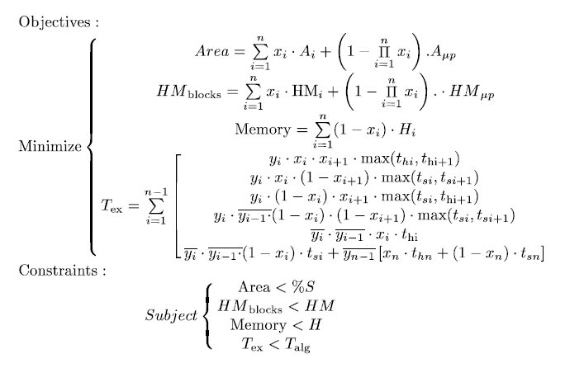
Hw/Sw Partitioning
Hardware/Software Codesign Guidelines for System on Chip FPGA-Based Sensorless AC Drive Applications
Mi = {M1, M2, … , M15} = Processes
Xi = {0, 1}, 0 = Software, 1 = Hardware
Yi = {0, 1}, 0 = Serial, 1 = Parallel
Aμp = Soft-Core Area
Area = Total Area Resources
HMblocks = Hardware Multipliers (DSPs)
HMμp = Hardware Multipliers (DSPs) by processor
Memory = Total Memory Use
Tex = Total Execution Time

Slide 13
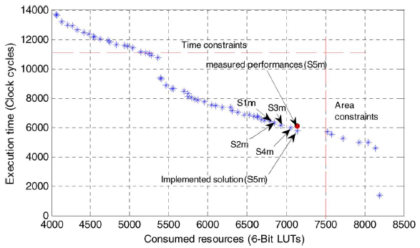
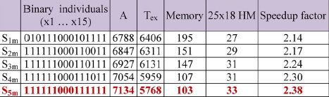
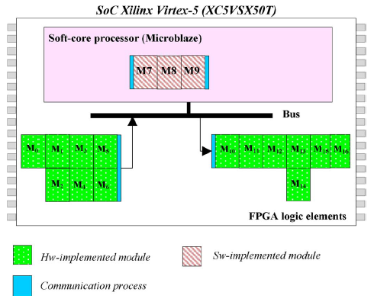
Nondominated Sorting Genetic Algorithm (NSGA II) Solutions
Hardware/Software Codesign Guidelines for System on Chip FPGA-Based Sensorless AC Drive Applications
5 Examples of Optimization Solutions
Pareto-front Nondominated Solutions
Execution Time of the NSGA-II was 1.38’ running in an
Intel Core i3 CPU 350 @2.27GHz, 4GB RAM
Scheduling Diagram of the Solution S5m

Slide 14
AC Motors &
Servo Systems
Working Principle
Architectural Segmentation/
Representation/Partitioning
Control Algorithm Requirements
Simulink Simulation
Experimental Topology

Slide 15
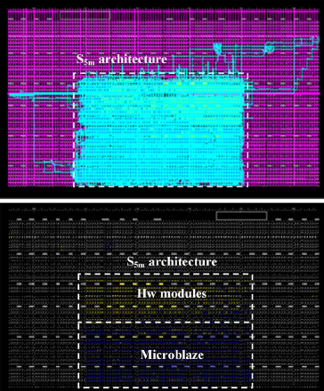
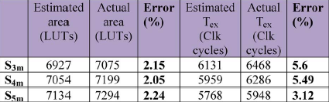
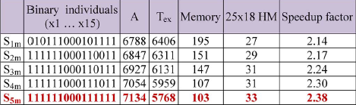
Previous Research of Fully Hardware and Fully Software Implementations
Hardware/Software Codesign Guidelines for System on Chip FPGA-Based Sensorless AC Drive Applications
Estimated-Actual Results of 3 Solutions
Area Maximum Error is 2.24%, which is quite accurate.
But, Timing Maximum Error is 5.6%, which is not so good.
This is because we did not take into consideration the communication latency between Hardware and Software Modules
Synthesized Architecture of S5m Solution in Virtex-5, XC5VSX50T

Slide 16
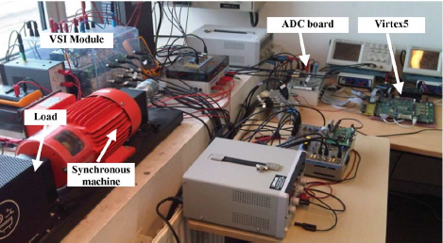
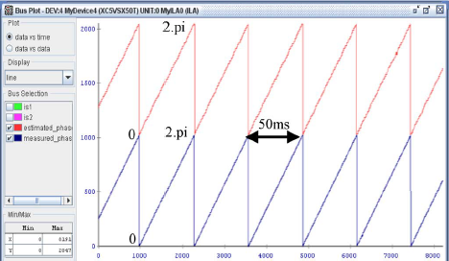
Experimental Topology & Results
Hardware/Software Codesign Guidelines for System on Chip FPGA-Based Sensorless AC Drive Applications
Experimental Topology
Estimated & Measured Angular Position at 500rpm

Slide 17

Questions for Conversation…
Why the phase margin was chosen 60$°$ ?
Why EKF Calculation, instead of Lyapunov, MRAS(Model Reference Adaptive System) or Sliding Mode Observer Method ?
Why FPGAs are not so common in commercial applications for AC Drive Applications ?

Slide 18

Thank you for your time
Questions?

